Slide 1




ISWC2014 Tutorial on Large Scale Reasoning Over Semantic Data
Presenters:
Jeff Z. Pan (University of Aberdeen)
Raghava Mutharaju (Wright State University)
Ilias Tachmazidis (University of Huddersfield)
Guilin Qi (Southeast University)

Slide 2
Agenda
9:10am – 9:45am
Motivations and Overview of Background Knowledge (Jeff, Ilias)
9:45am – 10:30am
Scalable OWL 2 DL reasoning based on approximation and divide-and-conquer approaches (Jeff)
10:30am – 11:00am
Coffee break
11:00am – 11:45am
Distributed Reasoning in OWL 2 EL (Raghava)
11:45am – 12:30pm
Large Scale Non-Monotonic Reasoning (Ilias)

Slide 3
Agenda
2:00pm – 2:45pm
Scalable RDFS Reasoning Using MapReduce (Raghava)
2:45pm – 3:30pm
Applications (Raghava, Jeff)
3:30pm – 4:00pm
Coffee break
4:00pm – 4:45pm
Lesson Learned and Conclusions (Jeff)

Slide 4

Scalable RDF Reasoning
Raghava Mutharaju (on behalf of Guilin)
Department of Computer Science,
Wright State University, USA

Slide 5

Session Agenda
RDFS Reasoning
MapReduce
MPI
Annotated RDF Reasoning

Slide 6
Motivation
RDF is a W3C standard language for semantic data
More and more RDF data are published as “linked” data
There is an increasing interest in representing additional information on top of RDF
Time, uncertainty, trust, and provenance
=> Annotated RDF(S)
Large amount of data
YAGO2
Notes:
Recently, there is an increasing trend to represent additional information, such as time, and uncertainty on top of standard RDF data. As a result, annotated RDF was proposed to meet this need.
At the same time, there are more and more data with annotation published online. One example is Yago2, which contains temporal information.
Therefore, large scale reasoning problem becomes more and more important.

Slide 7
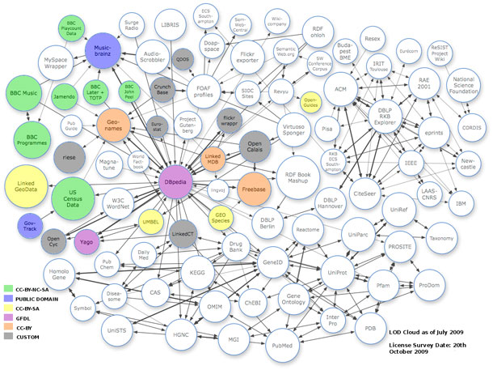



Web of Data
Problem: Large Scale Reasoning

Slide 8
MapReduce
WebPIE

Slide 9
Motivation (cont’d)
Recent work on scalable reasoning using MapReduce
WebPIE (ISWC’09, ESWC’10)
Fuzzy pD* (ISWC’11)
Temporal RDFS (AAAI’12)
Our contributions
Large scale annoated RDFS reasoning using MapReduce
Notes:
Recent studies have explored that MapReduce can be leveraged to achieve large scalability for the reasoning problem. For example, WebPIE calculated the closure of a data set containing over 100 billion triples. Our previous work has built an engine for scalable fuzzy pD* reasoning.
Therefore we suspect we can use MapReduce for the general scalable annotated RDF reasoning problem.

Slide 10
RDF
“Resource Description Framework”
W3C Recommendation 2004 http://www.w3.org/RDF/
RDF is a data model
originally for describing metadata for web pages, but has grown beyond that
structured information
universal, machine-readable data exchange format
main syntax uses XML for serialization

Slide 11
Background: RDF triples
An RDF triple consists of
Subject Predicate Object (borrowed from linguistics)
allowed are:
In the subject : URIs and empty nodes
In the predicate: URIs (usually called properties)
In the object: URIs and empty nodes and literals
Note that the graph can be reconstructed from the list of triples.

Slide 12
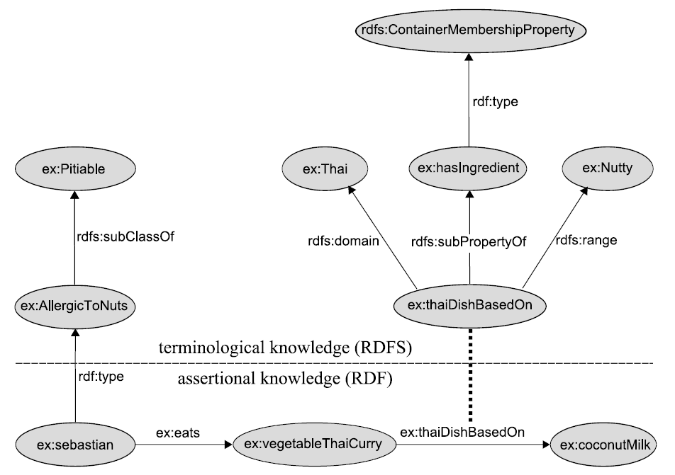
Background: Example

Slide 13
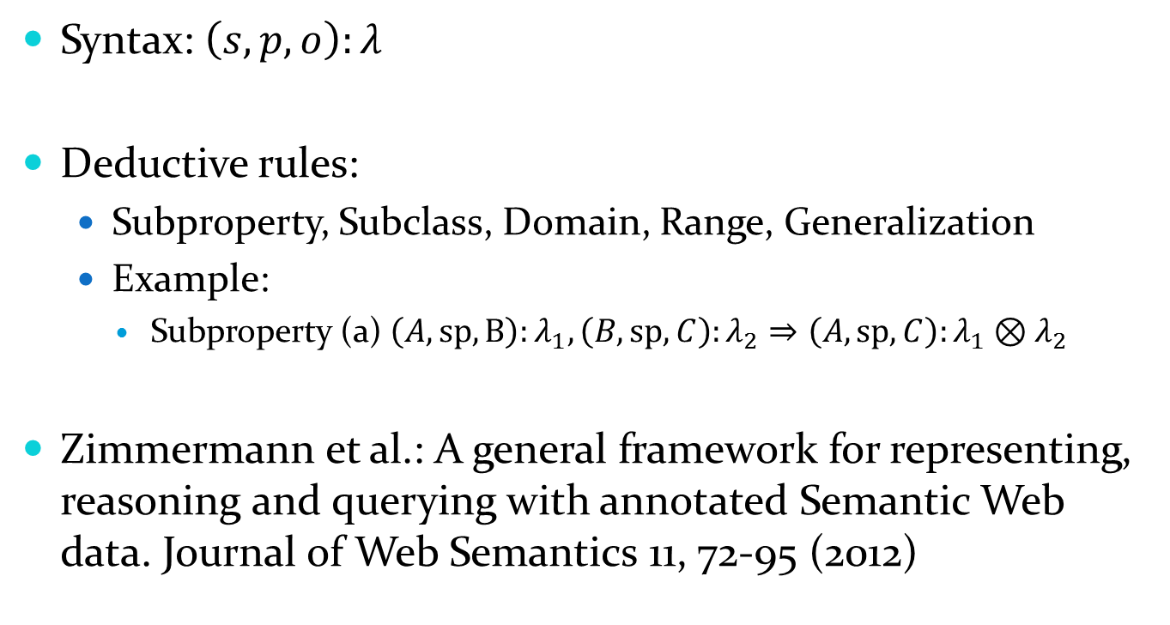
Background: Annotated RDF
Notes:
Our work is based on an annotated extension of $ρ$df, which was proposed in Zimmermann et al.
The syntax of an annotated triple is $\left(s, p, o\right):λ$. Here $λ$ is the annotation.
The deductive rules concern about subproperty, subclass, domain and range. One additional rule for the annotation setting is the generalisation rule, which will be explained in more details later.
Here is an example of a subproperty rule.

Slide 14
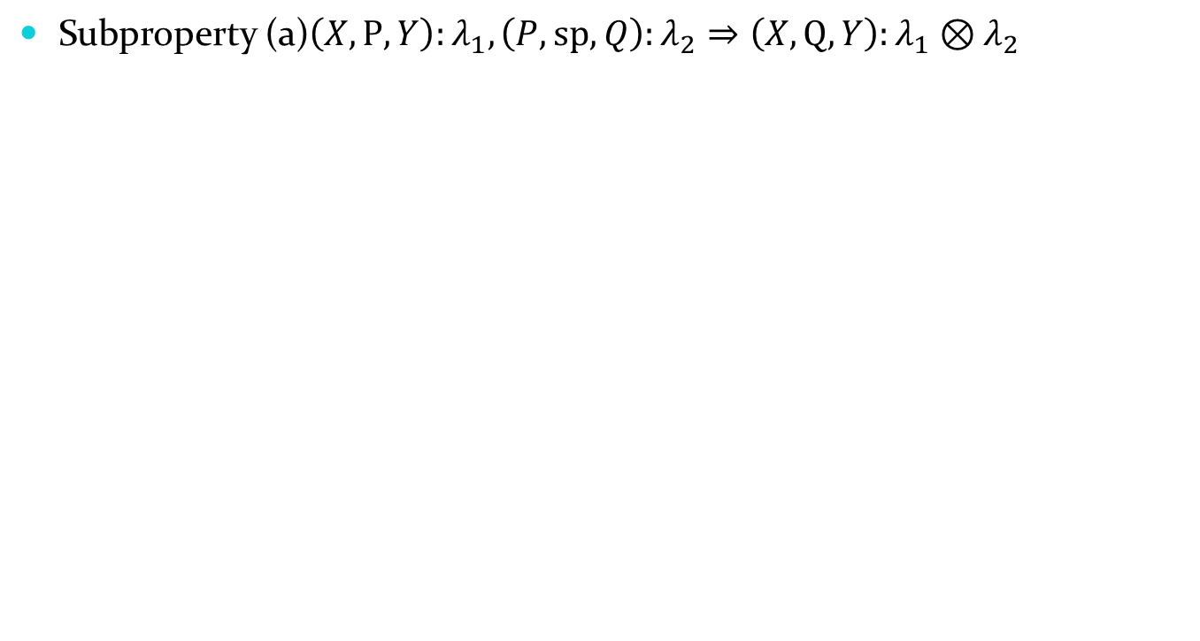
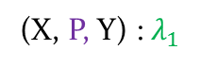
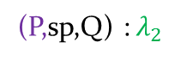
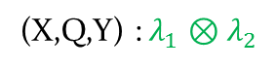
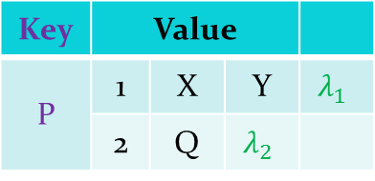
Naïve Implementation
Mapper
Mapper
Mapper
Key | Value
P | 1 | X | Y
 | 2 | Q
Reducer
Reducer
Reducer
Notes:
Here we explain a naïve implementation of a rule. The algorithm contains a map algorithm and a reduce algorithm.
In the mapper side triple are scanned to determine which patterns of premise it belongs to (e.g. (X,P,Y):lambda, or (P, sp, Q):lambda)
Then the mapper output a key/value pair if the triple matches a pattern. All the key/value pairs will be grouped together
In the reducer side, all groups will be processed. Since all triples with the same value on key column are grouped together, the reducer executes a Cartesian-join to produce the result.
Finally the join results will be produced.

Slide 15
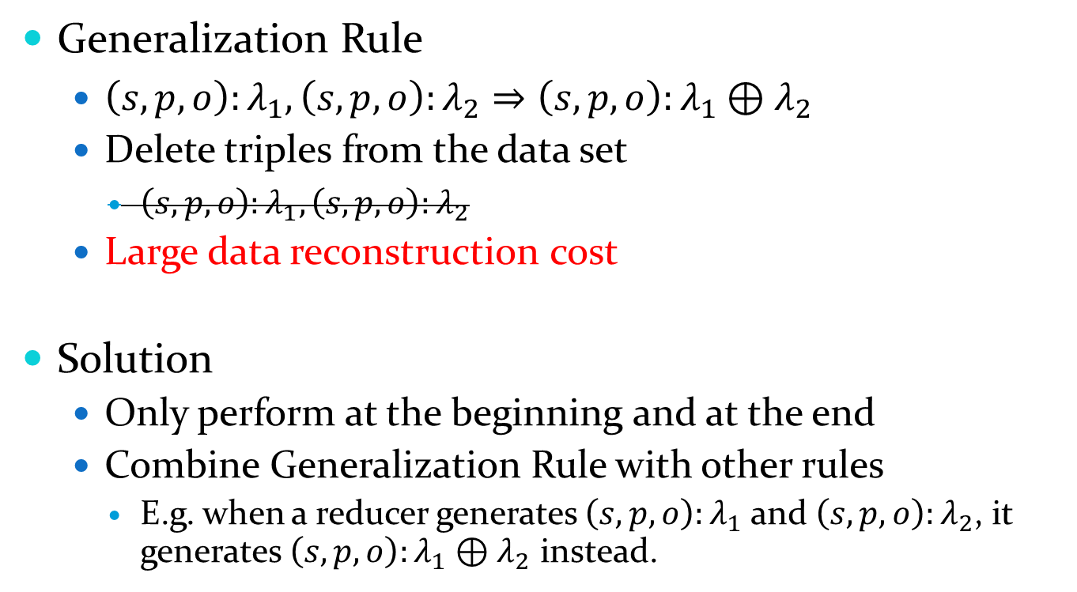
Challenges and solutions
Generalization Rule
$\left(s, p, o\right):λ_{1}, \left(s, p, o\right):λ_{2}⇒\left(s, p, o\right):λ_{1}⊕λ_{2}$
Delete triples from the data set
$\left(s, p, o\right):λ_{1},\left(s, p, o\right):λ_{2}$
Large data reconstruction cost
Solution
Only perform at the beginning and at the end
Combine Generalization Rule with other rules
E.g. when a reducer generates $\left(s, p, o\right):λ_{1}$ and $\left(s, p, o\right):λ_{2}$, it generates $\left(s, p, o\right):λ_{1}⊕λ_{2}$ instead.
Notes:
However, there are a lot of disadvantages of the naïve solution. Previous works have explored many optimizations which are also available for annotated RDF reasoning. Besides those, there are still several challenges that we should tackle.
1
The first challenge is about generalization rule. This is the only rule that will remove triples from the dataset. For example, after a successful application of this rule, two premises will be removed.
However, in a classical MapReduce file system, such as HDFS, data removal means a data reconstruction which is very cost.
2
To tackle this challenges. We only perform data reconstructions of generalization rule at beginning and at the end of the reasoning process.
Furthermore, we combine generalization rule along with other rules. For example, in the reduce algorithm, if the reducer finds it will generate two triples with the same triple part, it will generate the generalized result instead.

Slide 16
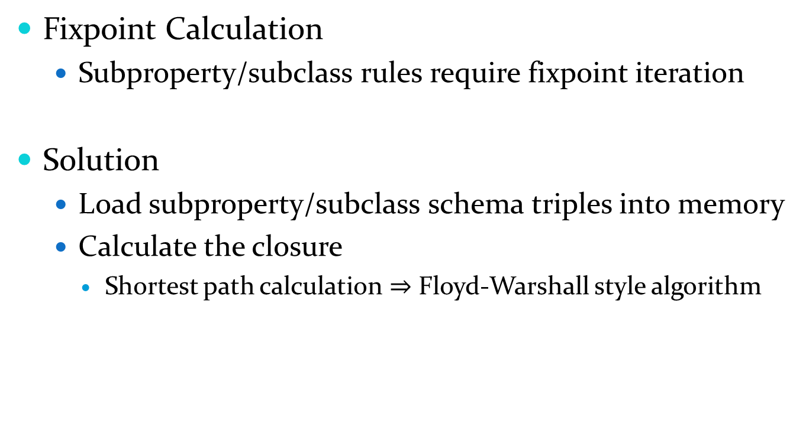


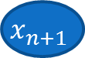
Challenges and solutions (cont’d)
Fixpoint Calculation
Subproperty/subclass rules require fixpoint iteration
Solution
Load subproperty/subclass schema triples into memory
Calculate the closure
Shortest path calculation $⇒$ Floyd-Warshall style algorithm
$$\left(x_{1}, sp, x_{2}\right):λ_{1}, \left(x_{2},sp, x_{3}\right):λ_{2},…,\left(x_{n}, sp, x_{n+1}\right):λ_{n}⇒\left(x_{1},sp, x_{n+1}\right):λ_{1}⊗…⊗λ_{n}$$
“Shortest” path
$$x_{1}$$
$$x_{2}$$
…
$$x_{n+1}$$
Notes:
The last challenge is about fixpoint iteration.
Bla bla…(The same as in this page)

Slide 17
Experiment setup
Dataset
Fuzzified DBPedia core ontology
fpdLUBM 1000, 2000, 4000, 8000
Cluster
25 machine with at most 75 mapper/reducer slots

Slide 18
Experiment result - fuzzy DBPedia
Dataset: fuzzified DBPedia core ontology
Results:
#units | 128 | 64 | 32 | 16 | 8 | 4 | 2
Time(sec.) | 122.653 | 136.861 | 146.393 | 170.859 | 282.802 | 446.917 | 822.269
Speedup | 6.70 | 6.01 | 5.62 | 4.81 | 2.91 | 1.84 | 1.00
Notes:
Here is our preliminary results on fuzzy dataset. We have reported this result in our previous paper. We fuzzify DBPedia core ontology by adding random fuzzy degree to each triple. We test our algorithms over different numbers of computing units, and we can see that the speedup is slightly smaller than the number of computing units. This is because a significant warmup overhead of Hadoop system. More details can be found in our paper.

Slide 19
Experiment result – fpdLUBM
Experimental results of FuzzyPD and WebPIE
Number of Universities | Time of FuzzyPD (minutes) | Time of WebPIE (minutes)
1000 | 38.8 | 41.32
2000 | 66.97 | 74.57
4000 | 110.40 | 130.87
8000 | 215.48 | 210.01

Slide 20
Experiment result– fpdLUBM (cont’d)
Scalability over number of units
Number of units | Time(minutes) | Speedup
128 | 38.80 | 4.01
64 | 53.15 | 2.93
32 | 91.58 | 1.70
16 | 155.47 | 1.00

Slide 21
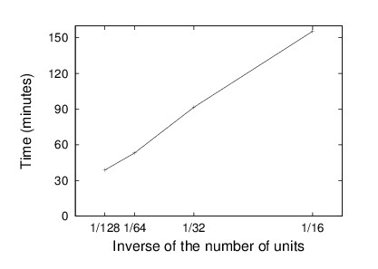
Experiment result– fpdLUBM (cont’d)
Scalability over number of units

Slide 22
Experiment result– fpdLUBM (cont’d)
Scalability over data volume
Number of universities | Input (Mtriples) | Output (Mtriples) | Time (minutes) | Throughput (Ktriples/second)
1000 | 155.51 | 92.01 | 38.8 | 39.52
2000 | 310.71 | 185.97 | 66.97 | 46.28
4000 | 621.46 | 380.06 | 110.40 | 57.37
8000 | 1243.20 | 792.54 | 215.50 | 61.29

Slide 23
Contact
For further questions, please contact Guilin Qi from Southeast University, China. Email is gqi@seu.edu.cn

